Slide 1

COMBUSTION IN POROUS MEDIA
Joshi Hrushikesh Ashutosh 20ME02002
Sanskaar Shrivastava 20ME02018
Vardhan Mittal 20ME02034
3rd Year Dual Degree
Under the guidance of
Dr. S. Kondaraju
School of Mehcanical Sciences
Indian Institute of Technology Bhubaneswar

Slide 2
CONTENTS
PROBLEM STATMENT
GOVERNING EQUATIONS
BOUNDARY & INITIAL CONDITIONS
SET-UP
ADVECTION VS. DIFFUSION
NUMERICAL SCHEME & ACCURACY
ALGORITHM
RESIDUALS
STABILTIY
GRID INDEPENDENCE
RESULTS
PHYSICS

Slide 3

PROBLEM STATEMENT
A premixed air-fuel mixture enters the combustion pipe from the inlet.
Inside the pipe is placed a plate made of porous material which serves as our porous medium.
The air-fuel mixture undergoes combustion in the porous plate. Thus, the flame is held in the plate.
Fresh air-fuel mixture continues to enter from the inlet and leave from the outlet after combustion.
FUEL + AIR
INLET
FUEL + AIR
OUTLET
POROUS MEDIUM
PIPE
SCHEMATIC OF THE SET-UP

Slide 4
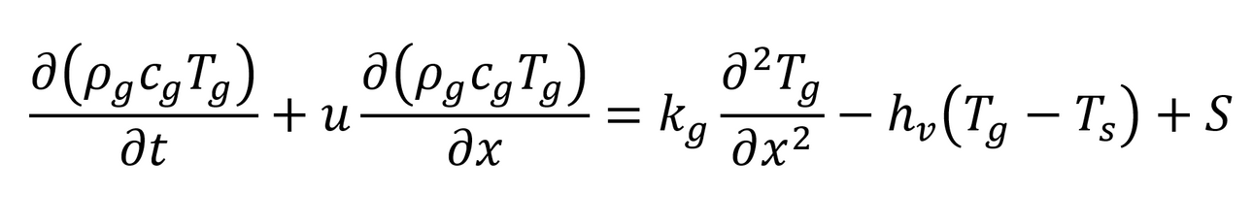
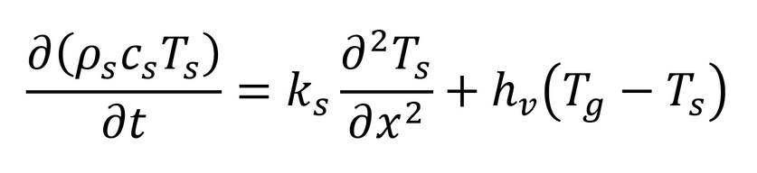
GOVERNING EQUATIONS
The system can be modeled as two separate energy equations.
The air-fuel mixture is treated as a homogenous gas while the porous medium is treated as a homogenous solid, both with constant properties.
Combustion is modeled as a constant heat source term released at a certain location in the porous medium.
For the air-fuel mixture:
For the porous medium:

Slide 5
BOUNDARY & INITIAL CONDITIONS
Initial Conditions:
The porous plate and the air-fuel mixture are both at 473K.
Boundary Conditions:
The inlet temperature is 473K
The outlet is at zero temperature gradient.
OUTLET
(Zero Temperature Gradient)
INLET
(473K)
POROUS MEDIUM
(INITIALLY AT 473K)
AIR-FUEL MIXTURE (INITIALLY AT 473K)
BOUNDARY CONDITIONS OF THE SET-UP

Slide 6
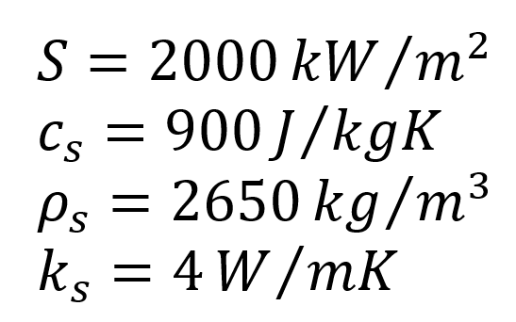
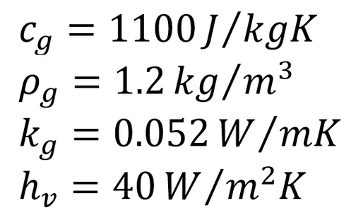

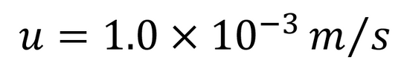

SET-UP
The values of the parameters used for the simulation are:
The simulation is run at three different velocities:

Slide 7
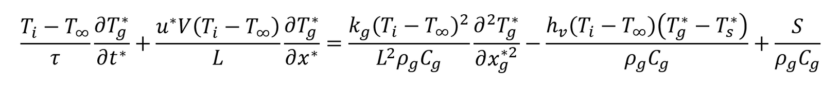
ADVECTION VS. DIFFUSION
For the air-fuel mixture:
The governing equation for the air-fuel mixture have advection as well as diffusion terms.
Depending upon the values of the set-up parameters along with the velocity of the air-fuel mixture, the system will either have advection or diffusion as the dominating factor.
For analysis, the governing equations are non-dimensionalized and the values of the coefficients compared. Velocities above the threshold are advection dominant while below it are diffusion dominant.
ADVECTION
DIFFUSION

Slide 8
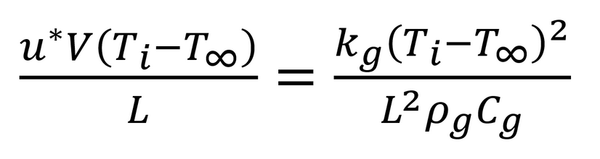
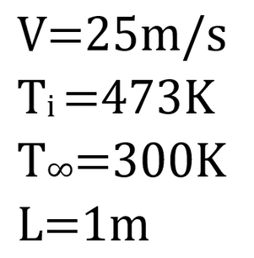

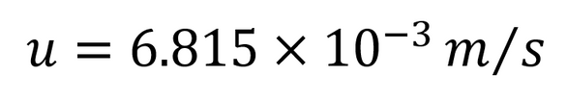
ADVECTION VS. DIFFUSION
Equating the coefficients of advection and diffusion terms:
For the values of:
The value of the non-dimensional velocity is:
The value of threshold velocity is:

Slide 9
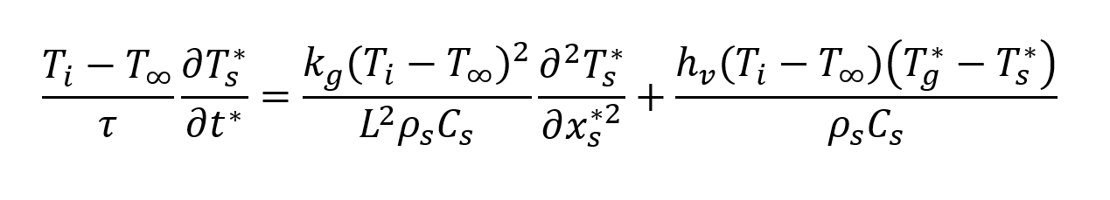
ADVECTION VS. DIFFUSION
For the porous medium:
The porous medium does not have any advection terms.
The porous medium has only diffusion.
DIFFUSION

Slide 10
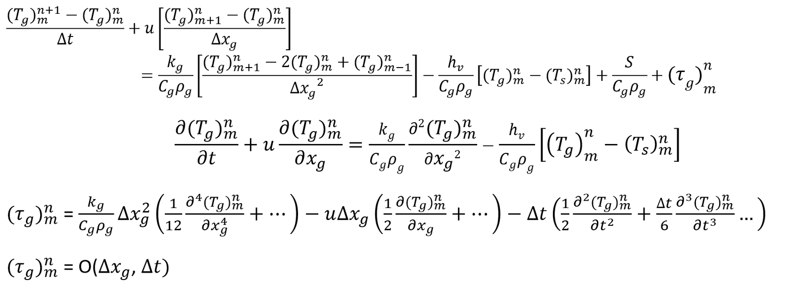
NUMERICAL SCHEME & ACCURACY
The two differential equations have been discretized using forward time and central space (FTCS) scheme.
Within the constraints of the problem, FTCS provides a computationally inexpensive and reasonably accurate way to simulate the system.
For the air-fuel mixture:

Slide 11
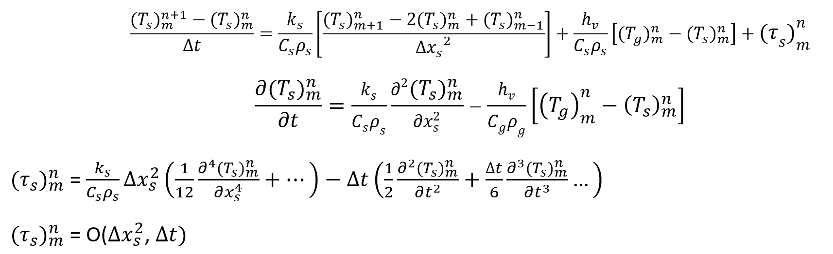
NUMERICAL SCHEME & ACCURACY
For the porous medium:

Slide 12
STABILITY
For stability analysis, CFL numbers are calculated.
The most stringent number is 10^-4 and is taken as target and velocities chosen.
TYPE | VALUE
Air-Fuel Advection | 10^-4
Air-Fuel Diffusion | 7.87x10^-3
Solid Diffusion | 3.35x10^-4

Slide 13
ALGORITHM
Make separate grids of the same resolution but different sizes for the solid and gaseous parts.
Define the time step.
Declare the boundary conditions.
Select the value of the velocity as per advection or diffusion dominance.
Discretize the equations using FTCS.
For time step 'n', plug the required values in the discretized equations to get the values of temperature of the next step.
Repeat step 6 from the 1st to the last time step.

Slide 14
RESIDUALS
For the calculation of the residuals, the temperature data generated from the simulation is plugged into the original difference equations.
The data is taken at three different nodes corresponding to the solid grid and the gaseous air-fuel mixture grid.
The target was set as >0.1 and all the three test nodes satisfied the target for both grids.
Node Number | Solid Residual Value (*10^-2) | Gaseous Residual Value (*10^-4)
5 | 8.5209696 | -1.6771823
60 | -0.0165757 | -1.6771320
92 | -1.5606060 | -8.3385744

Slide 15
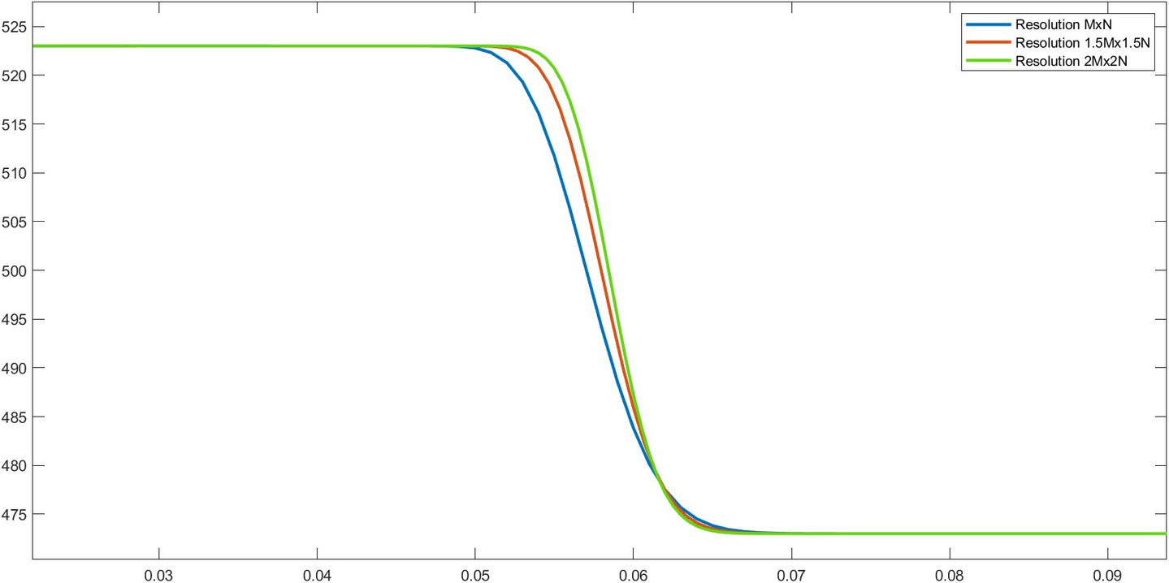
GRID INDEPENDENCE
The simulation is run for 10^-3 m/s at 3 different resolutions.
Maximum difference between two grid resolutions was 0.022K.
COLOUR | SOLIDxTIME
Blue | 50x100000
Red | 75x150000
Green | 100x200000

Slide 16
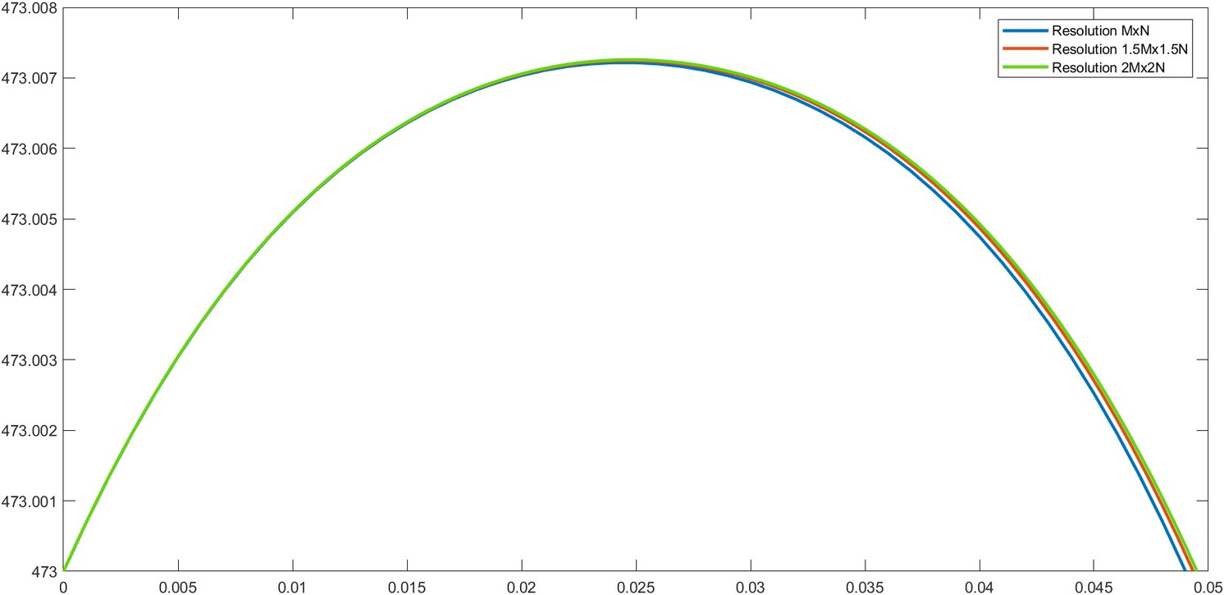
GRID INDEPENDENCE
COLOUR | GASxTIME
Blue | 2000x100000
Red | 3000x150000
Green | 4000x200000

Slide 17
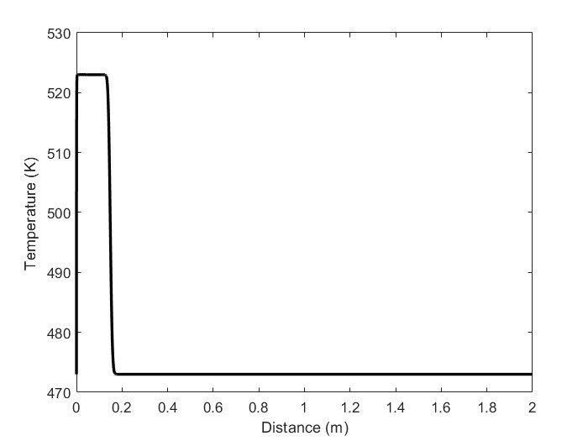
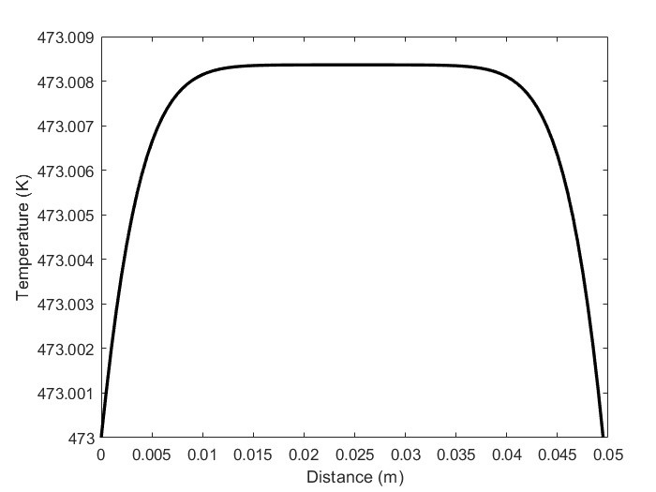
RESULTS
Velocity=10^-2 m/s
Air-Fuel Mixture
Porous Medium

Slide 18
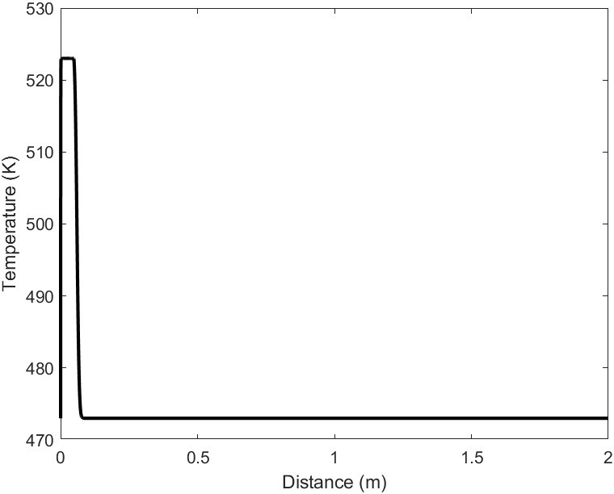
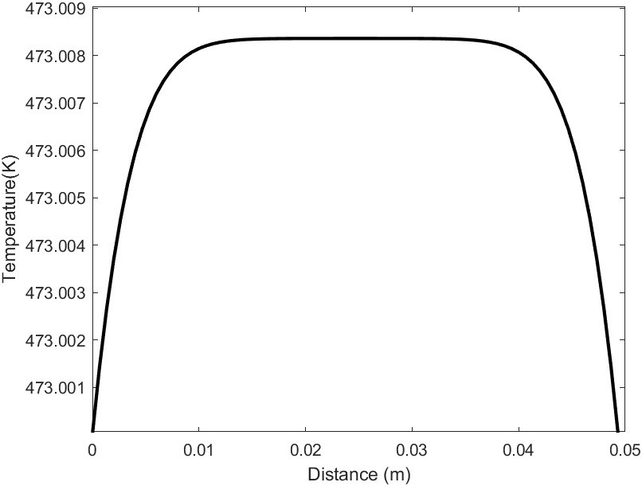
RESULTS
Velocity=10^-3 m/s
Air-Fuel Mixture
Porous Medium

Slide 19
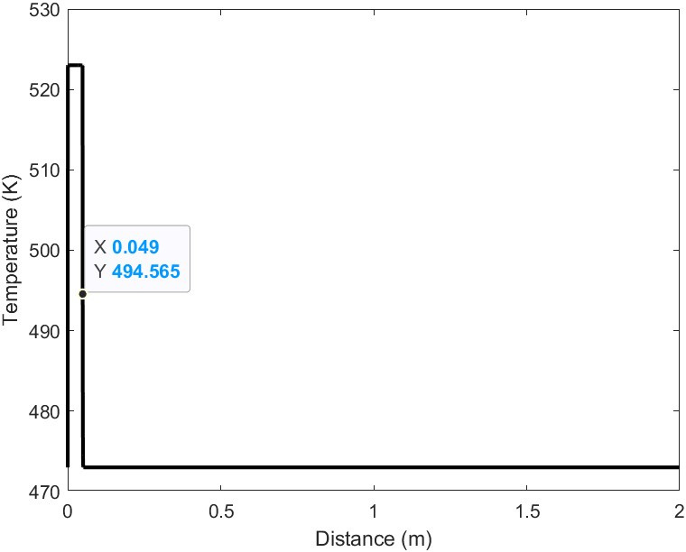
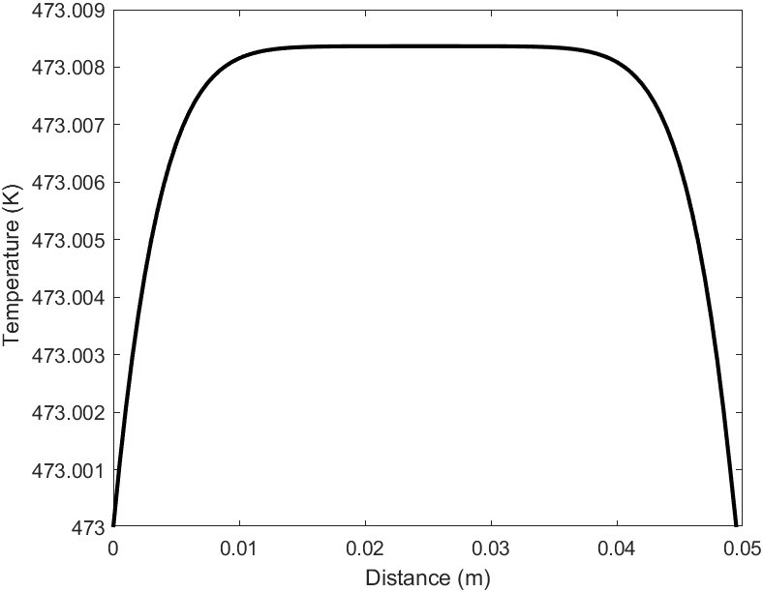
RESULTS
Velocity=10^-6 m/s
Air-Fuel Mixture
Porous Medium

Slide 20
PHYSICS
The system is seen to have a spike in temperature for the gaseous phase as it passes through the porous medium.
The rise in temperature is expected as the gas picks up heat from the flame in the porous medium.
Sufficient length of pipe is taken to allow for temperature gradient to go to zero after the porous medium as is seen from the graphs.
For the diffusion dominant case, the drop in temperature as diffusion takes over shows a smoother variation than for the advection dominant term.
For the solid, the temperature profile is a concave downward curve as is expected because of the diffusion of heat in the entire solid.

Slide 21
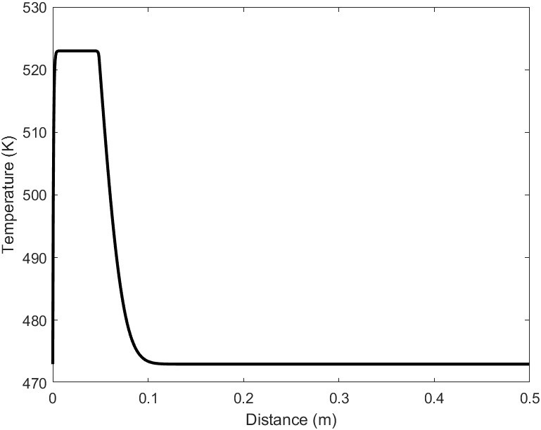
PHYSICS
The faster the velocity, the more dominating is the advection part of the equation.
Thus, to illustrate the dominance of advection over diffusion and vice-versa, the diffusion constants are changed by a factor of 1000 to allow for faster diffusion.
Thus, the temperature gradient "smoothens-out" due to increased diffusion.
It is to be noted that this is just a demonstration and does not hold any real world significance.

Slide 22
THANK YOU

